Slide 1
~ What is Robotics?
- The branch of technology that deals with the design, construction, operation, and application of robots
~ What are some Robots we use every Day?
~ Why do We need Robots?
- Robots can perform tasks with a level of consistency and precision the Humans could not achieve.
- Robots can do tasks repetitively where as humans can be injured by such Repitition.

Slide 2
What is an Engineer?
Video Courtesy of University of New Castle

Slide 3


Slide 4
~What is programming and what does it have to do with robotics?
- Programing is the act of writing instructions in a form that Computers and or Robots can understand.
- Programs are what tell a robot what to do and how to do it.
~ Why Python?
- Python has a very large library meaning there are Tons of possibilities.
- Python is Cross platform meaning most Computer platforms can run it.
- Python is easy to learn.

Slide 5
Using MobaXterm

Slide 6
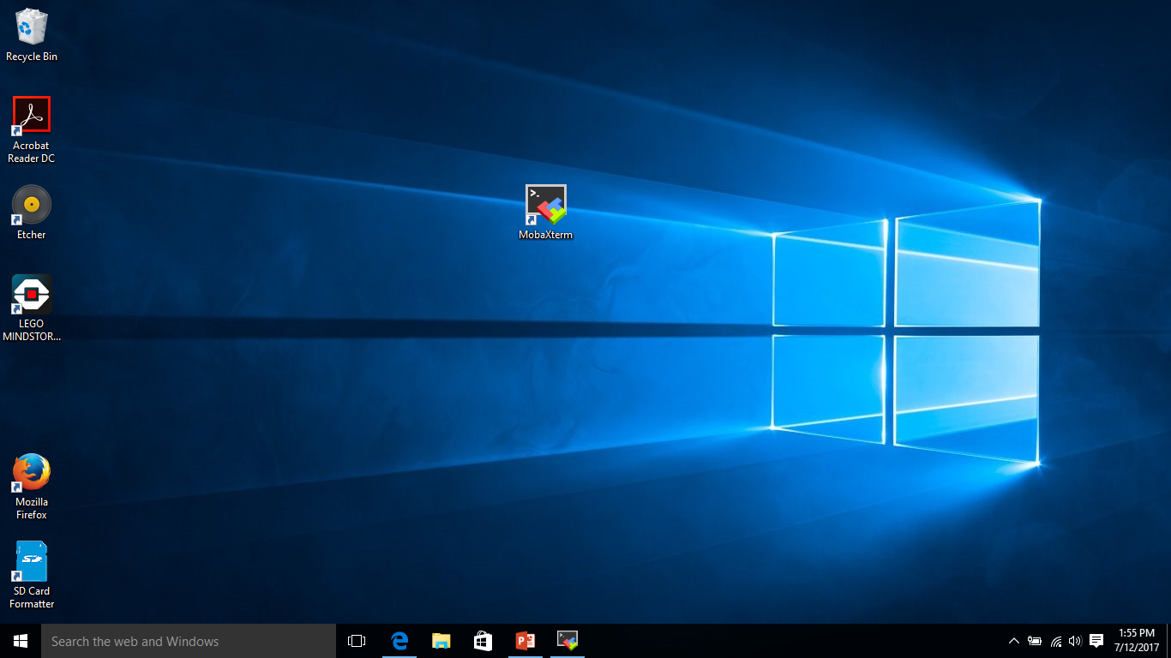

Slide 7
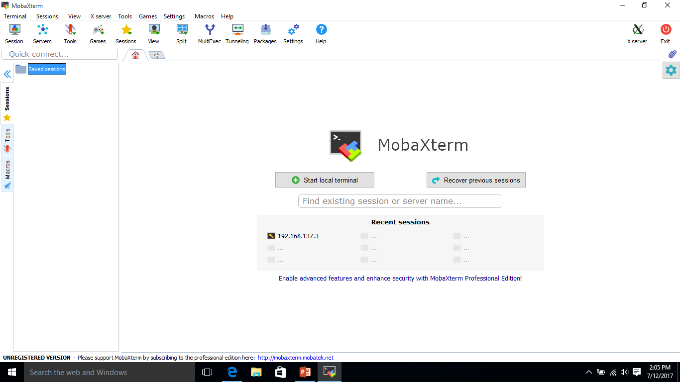

Slide 8
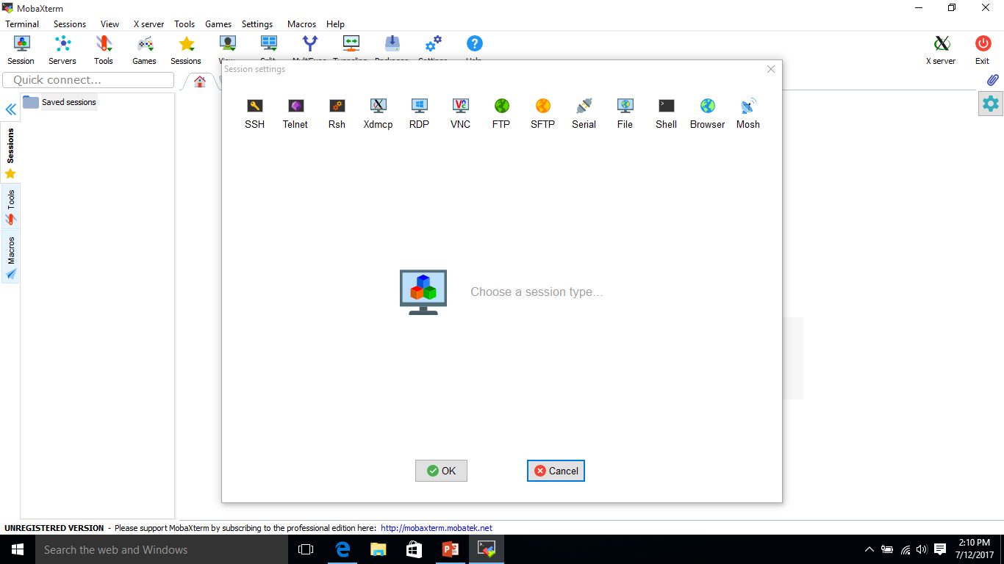

Slide 9
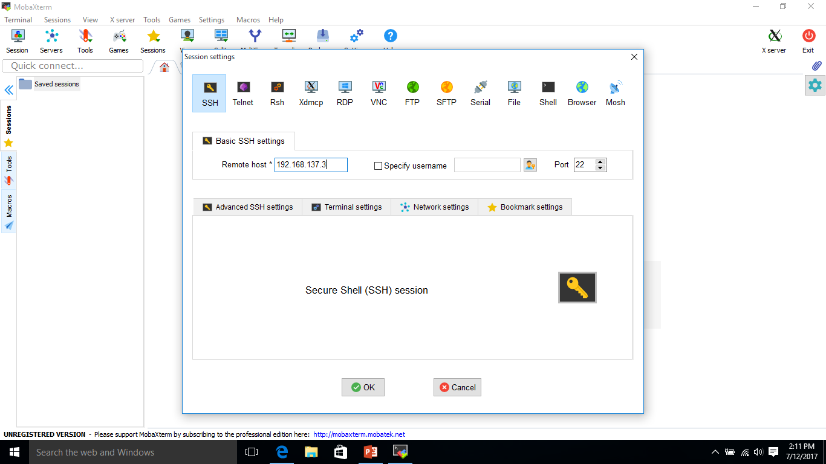

Slide 10
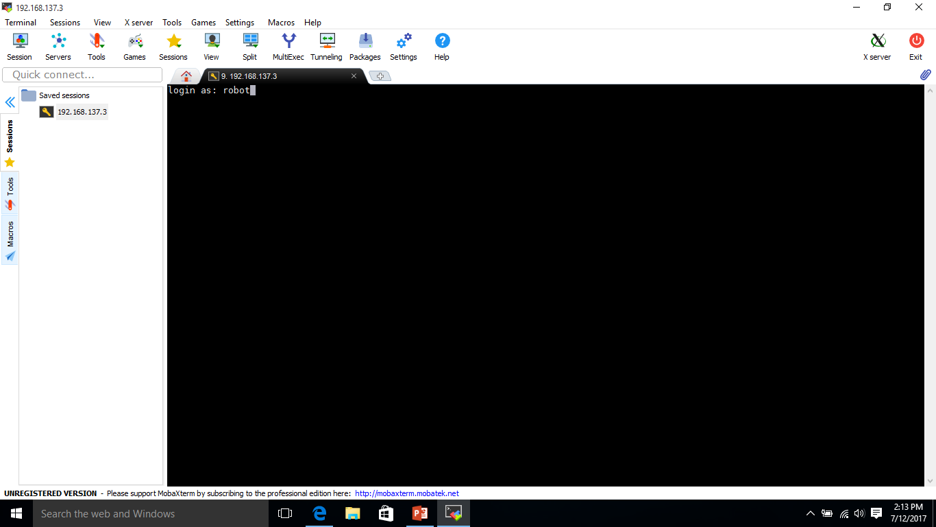
robot

Slide 11
If needed enter the password: maker
If needed Enter the password: maker

Slide 12
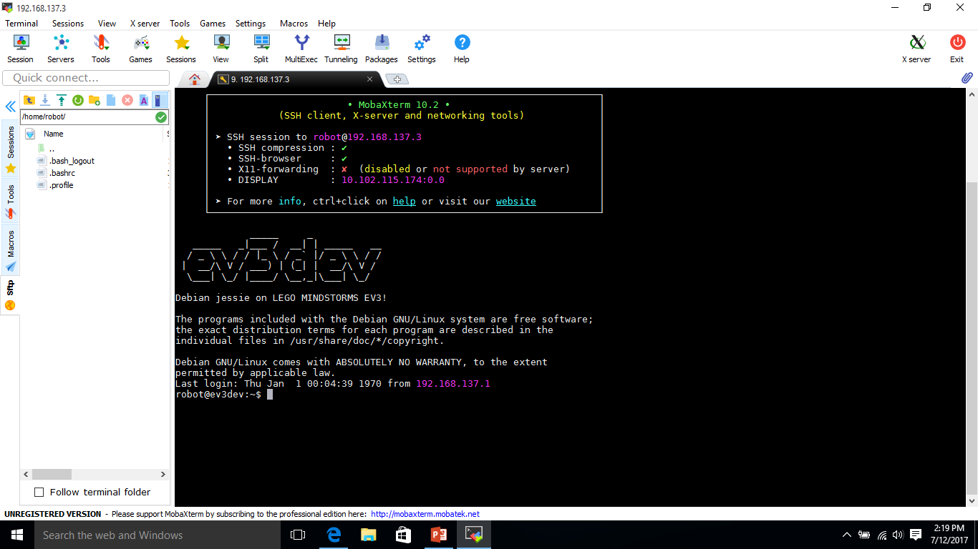

Slide 13
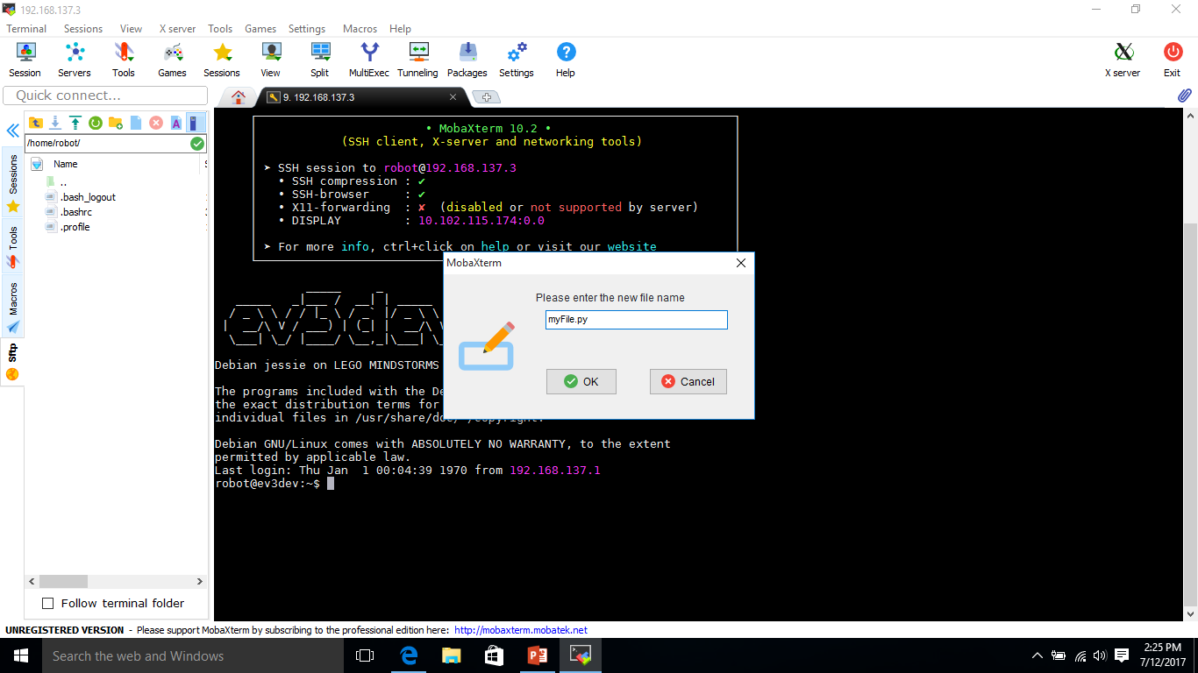
Enter a Name ending in .py

Slide 14


Slide 15
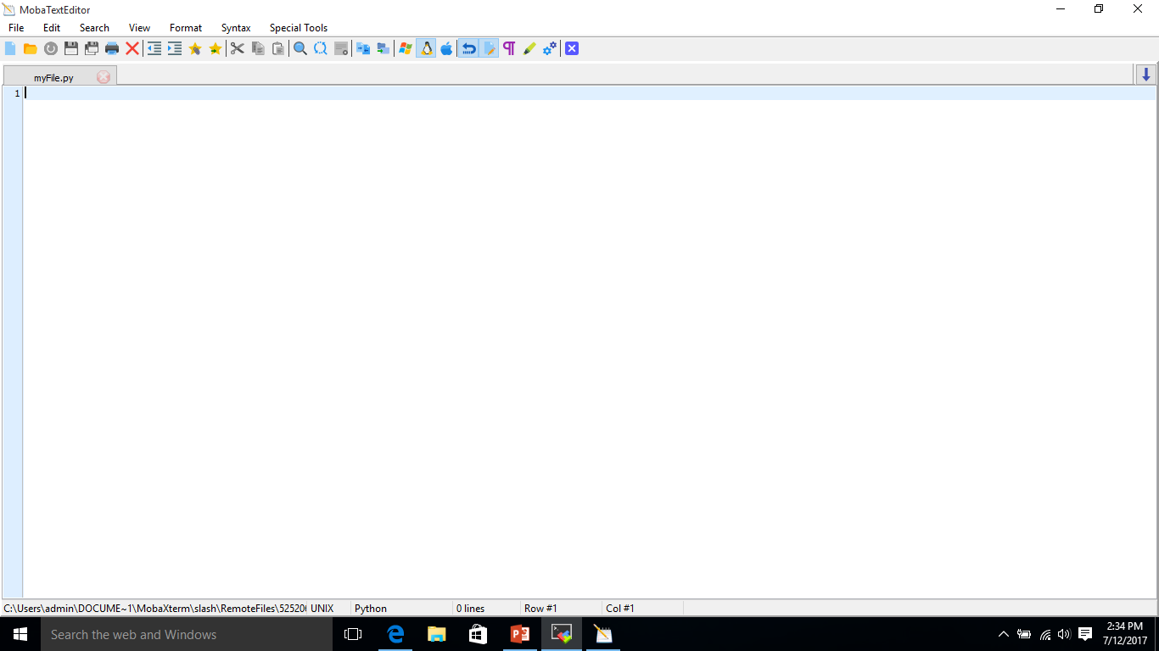

Slide 16
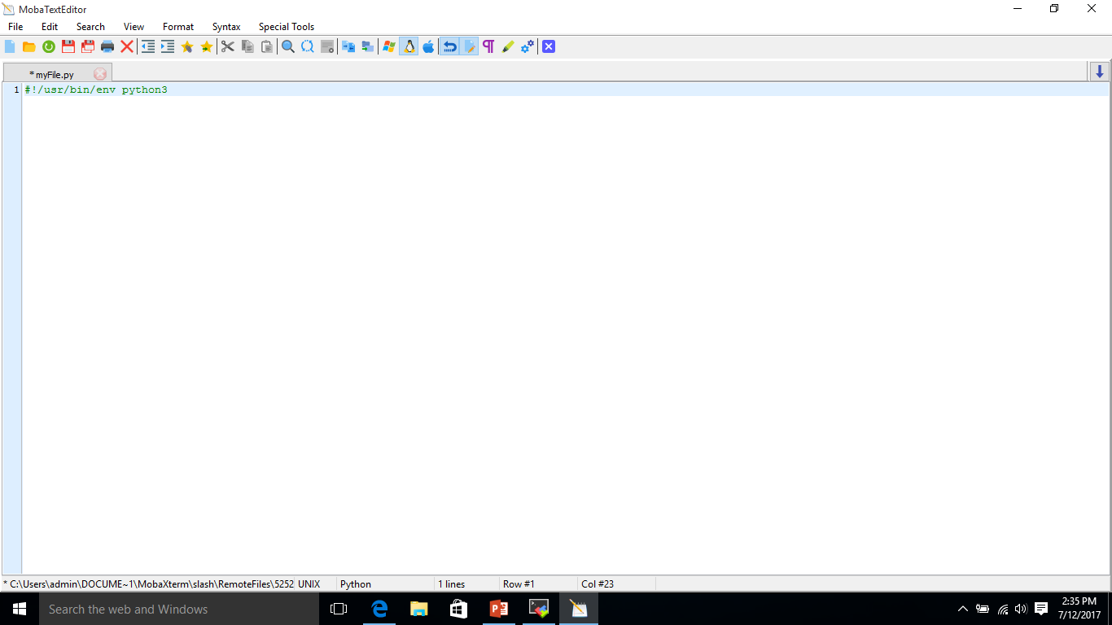

Slide 17
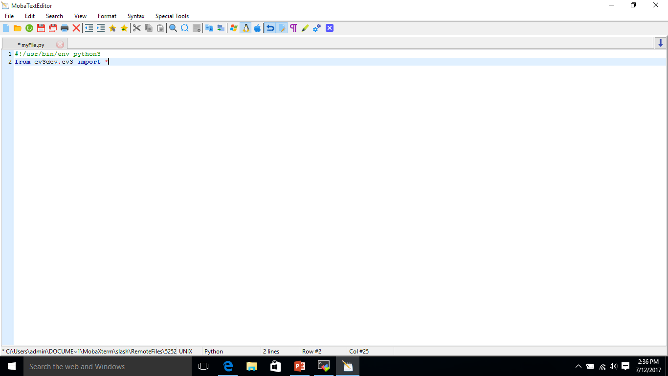

Slide 18
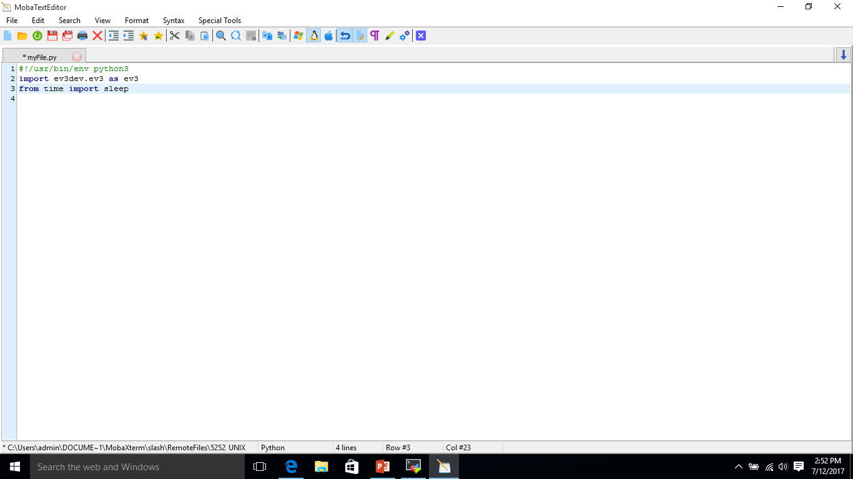

Slide 19


Slide 20
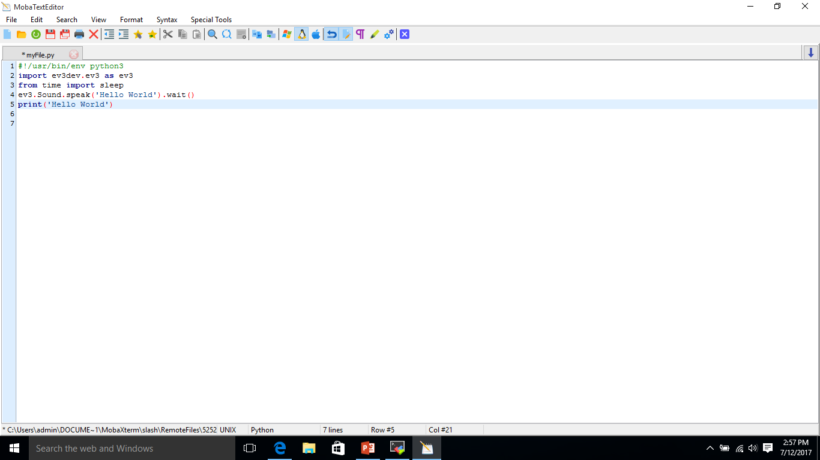

Slide 21
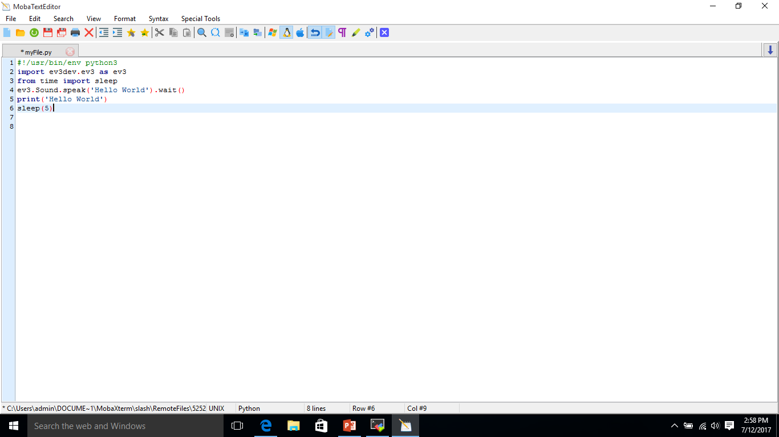

Slide 22


Slide 23
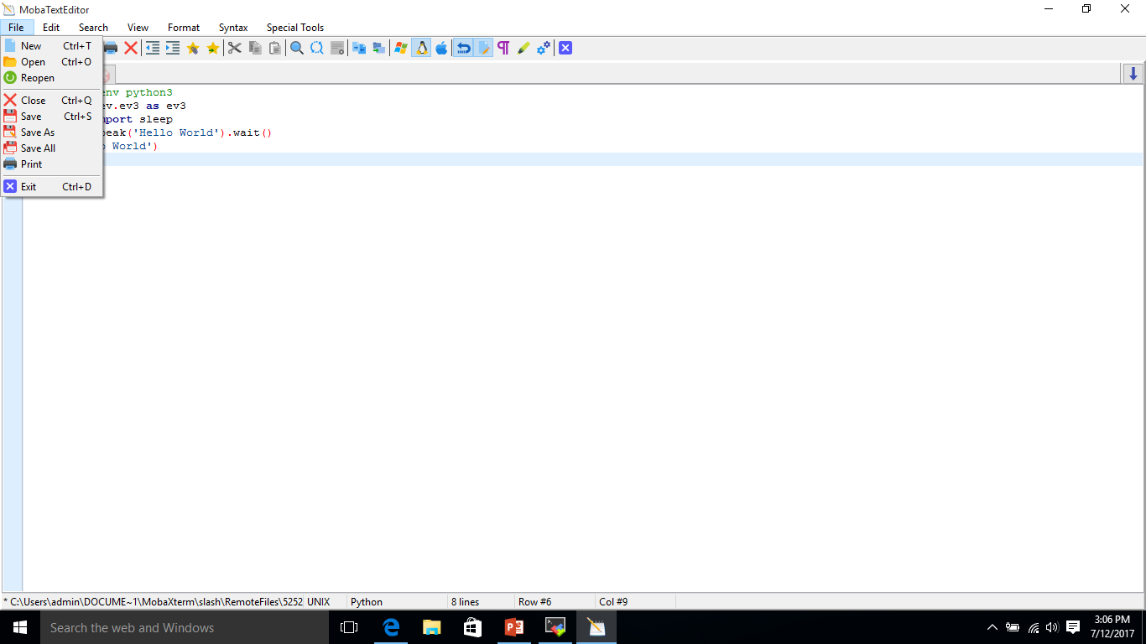

Slide 24
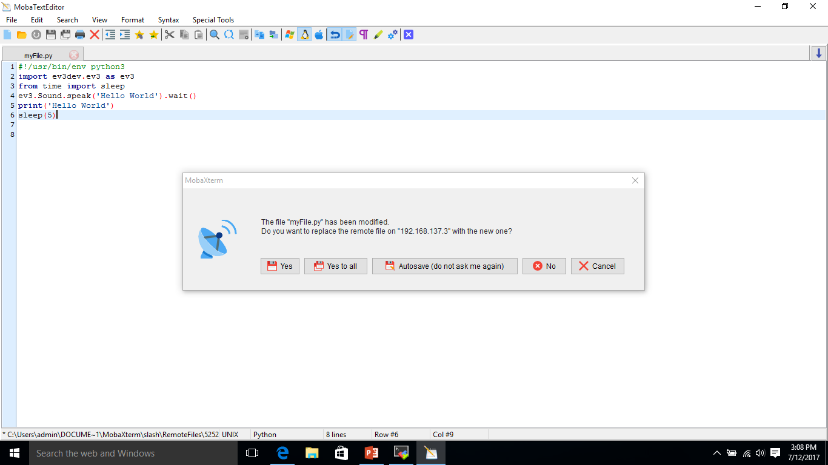

Slide 25
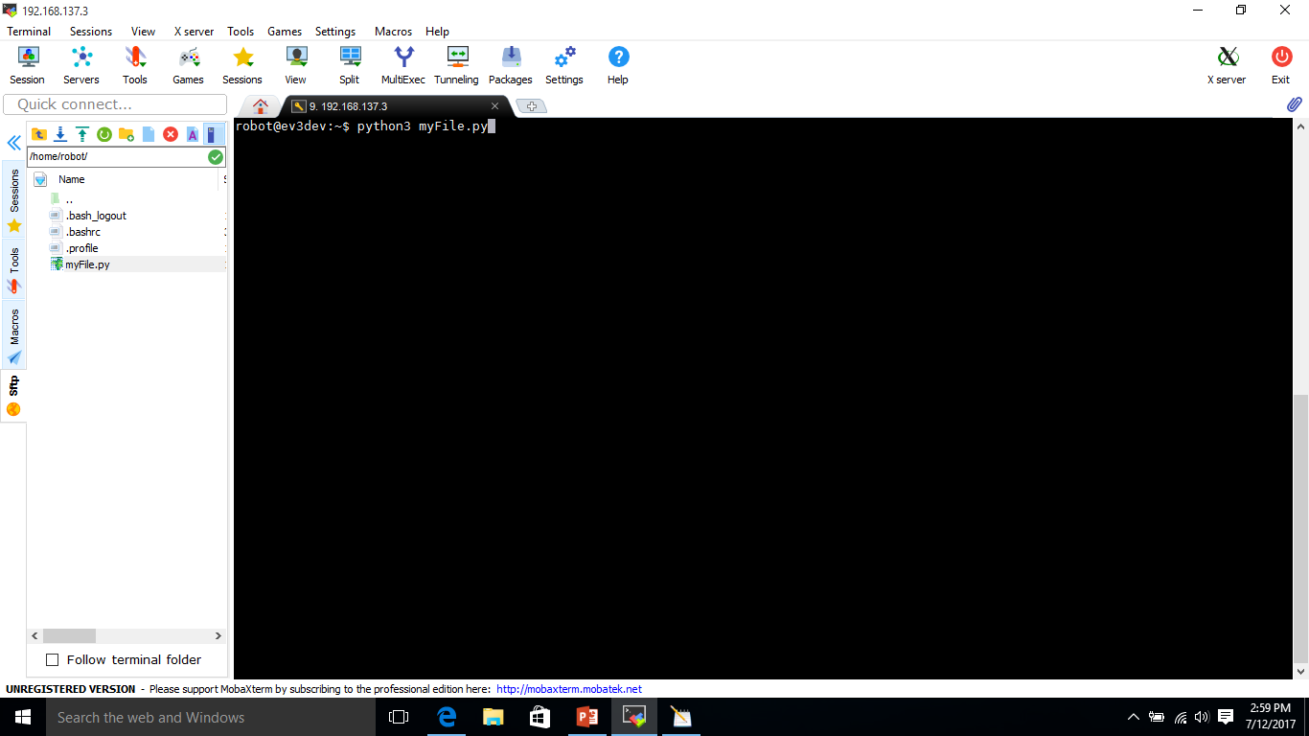

Slide 26


Slide 27
Challenge
Make a Program that says your name.

